Slide 1
Chapter 7 Mircoarchitecture (1)
Suffolk County Community College
CSE 222, Spring 2020

Slide 2
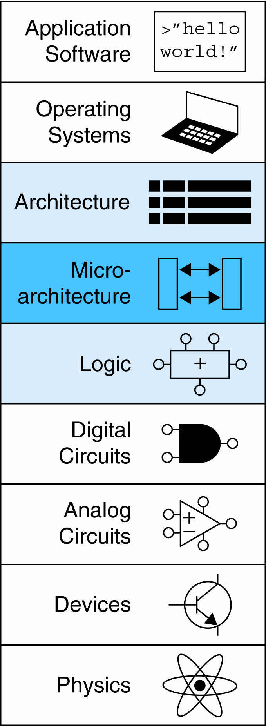
Topics:
Introduction
Performance Analysis
Single-Cycle Processor
Multicycle Processor
Pipelined Processor
Exceptions
Advanced Microarchitecture

Slide 3
Introduction
Microarchitecture
How to implement an architecture in hardware
Processor:
Datapath: functional blocks
Control: control signals

Slide 4
Microarchitecture
Multiple implementations for a single architecture:
Single-cycle:
Each instruction executes in a single cycle
Multicycle:
Each instruction is broken into series of shorter steps
Pipelined:
Each instruction broken up into series of steps & multiple instructions execute at once

Slide 5
Processor Performance
Program execution time :
Execution Time = (#instructions)(cycles/instruction)(seconds/cycle)
Definitions:
CPI: cycles/instruction
clock period: seconds/cycle
IPC: instructions/cycle
Challenge is to satisfy constraints of:
Cost
Power
Performance

Slide 6
MIPS Processor
Consider subset of MIPS instructions:
R-type instructions: and, or, add, sub, slt
Memory instructions: lw, sw
Branch instructions: beq

Slide 7
Architectural State
Determines everything about a processor:
PC
32 registers
Memory
Turing Machine
https://www.cl.cam.ac.uk/projects/raspberrypi/tutorials/turing-machine/one.html

Slide 8
MIPS State Elements

Slide 9
Single–Cycle MIPS Processor
Datapath
Operates on words of data
Contains structures of memories, registers, ALUs, multiplexer
Control
Control unit produces multiplexer select, register enable, memory write signals to control the operation of datapath
Notes:
Once you’ve learned one architecture, it’s easy to learn others

Slide 10
Single–Cycle Datapath: lw: fetch
STEP 1: Fetch instruction
Notes:
MIPS instruction: lw $rs, $rt, imm
Machine code: lw $rt, offset($rs)
imm = offset

Slide 11
Single–Cycle Datapath: lw: Register Read
STEP 2: Read source operands from RF

Slide 12
Single–Cycle Datapath: lw: Immediate
STEP 3: Sign-extend the immediate

Slide 13
Single–Cycle Datapath: lw: Address
STEP 4: Compute the memory address

Slide 14
Single–Cycle Datapath: lw: Memory Read
STEP 5: Read data from memory and write it back to register file

Slide 15
Single–Cycle Datapath: lw: PC Increment
STEP 6: Determine address of next instruction

Slide 16
Single–Cycle Datapath: sw
SW: Write data in rt to memory

Slide 17
Single–Cycle Datapath: R-type
Read from rs and rt
Write ALUResult to register file
Write to rd (instead of rt)

Slide 18
Single–Cycle Datapath: beq
Determine whether values in rs and rt are equal
Calculate branch target address:
BTA = (sign-extended immediate << 2) + (PC+4)

Slide 19
Single–Cycle Processor
Notes:
Once you’ve learned one architecture, it’s easy to learn others

Slide 20
Single–Cycle Control

Slide 21
Review: ALU
F_{2:0} | Function
000 | A & B
001 | A | B
010 | A + B
011 | not used
100 | A & ~B
101 | A | ~B
110 | A - B
111 | SLT

Slide 22
Control Unit: ALU Decoder
ALUOp_{1:0} | Meaning
00 | Add
01 | Subtract
10 | Look at Funct
11 | Not Used
ALUOp_{1:0} | Funct | ALUControl_{2:0}
00 | X | 010 (Add)
X1 | X | 110 (Subtract)
1X | 100000 (add) | 010 (Add)
1X | 100010 (sub) | 110 (Subtract)
1X | 100100 (and) | 000 (And)
1X | 100101 (or) | 001 (Or)
1X | 101010 (slt) | 111 (SLT)

Slide 23
Control Unit Main Decoder
Instruction | Op_{5:0} | RegWrite | RegDst | AluSrc | Branch | MemWrite | MemtoReg | ALUOp_{1:0}
R-type | 000000
lw | 100011
sw | 101011
beq | 000100
Notes:
Once you’ve learned one architecture, it’s easy to learn others

Slide 24
Control Unit Main Decoder
Instruction | Op_{5:0} | RegWrite | RegDst | AluSrc | Branch | MemWrite | MemtoReg | ALUOp_{1:0}
R-type | 000000 | 1 | 1 | 0 | 0 | 0 | 0 | 10
lw | 100011 | 1 | 0 | 1 | 0 | 0 | 1 | 00
sw | 101011 | 0 | X | 1 | 0 | 1 | X | 00
beq | 000100 | 0 | X | 0 | 1 | 0 | X | 01

Slide 25
Single-Cycle Datapath: or

Slide 26
Extended Functionality: addi

Slide 27
Control Unit: addi
Instruction | Op_{5:0} | RegWrite | RegDst | AluSrc | Branch | MemWrite | MemtoReg | ALUOp_{1:0}
R-type | 000000 | 1 | 1 | 0 | 0 | 0 | 0 | 10
lw | 100011 | 1 | 0 | 1 | 0 | 0 | 1 | 00
sw | 101011 | 0 | X | 1 | 0 | 1 | X | 00
beq | 000100 | 0 | X | 0 | 1 | 0 | X | 01
addi | 001000

Slide 28
Control Unit: addi
Instruction | Op_{5:0} | RegWrite | RegDst | AluSrc | Branch | MemWrite | MemtoReg | ALUOp_{1:0}
R-type | 000000 | 1 | 1 | 0 | 0 | 0 | 0 | 10
lw | 100011 | 1 | 0 | 1 | 0 | 0 | 1 | 00
sw | 101011 | 0 | X | 1 | 0 | 1 | X | 00
beq | 000100 | 0 | X | 0 | 1 | 0 | X | 01
addi | 001000 | 1 | 0 | 1 | 0 | 0 | 0 | 00

Slide 29
Extended Functionality: j

Slide 30
Control Unit: j
Instruction | Op_{5:0} | RegWrite | RegDst | AluSrc | Branch | MemWrite | MemtoReg | ALUOp_{1:0} | Jump
R-type | 000000 | 1 | 1 | 0 | 0 | 0 | 0 | 10 | 0
lw | 100011 | 1 | 0 | 1 | 0 | 0 | 1 | 00 | 0
sw | 101011 | 0 | X | 1 | 0 | 1 | X | 00 | 0
beq | 000100 | 0 | X | 0 | 1 | 0 | X | 01 | 0
j | 000100

Slide 31
Control Unit: j
Instruction | Op_{5:0} | RegWrite | RegDst | AluSrc | Branch | MemWrite | MemtoReg | ALUOp_{1:0} | Jump
R-type | 000000 | 1 | 1 | 0 | 0 | 0 | 0 | 10 | 0
lw | 100011 | 1 | 0 | 1 | 0 | 0 | 1 | 00 | 0
sw | 101011 | 0 | X | 1 | 0 | 1 | X | 00 | 0
beq | 000100 | 0 | X | 0 | 1 | 0 | X | 01 | 0
j | 000100 | 0 | X | X | X | 0 | X | XX | 1

Slide 32
Processor Performance
Program Execution Time
= (#instructions)(cycles/instruction)(seconds/cycle)
= # instructions x CPI x T_{C}

Slide 33
Single-Cycle Performance
T_{C} limited by critical path (lw)

Slide 34
Single-Cycle Performance
Single-cycle critical path:
T_{c} = t_{pcq_PC} + t_{mem} + max(t_{RFread}, t_{sext} + t_{mux}) + t_{ALU} + t_{mem} + t_{mux} + t_{RFsetup}
Typically, limiting paths are:
memory, ALU, register file
T_{c} = t_{pcq_PC} + 2t_{mem} + t_{RFread} + t_{mux} + t_{ALU} + t_{RFsetup}

Slide 35
Single-Cycle Performance
Example:
Element | Parameter | Delay (ps)
Register clock-to-Q | t_{pcq_PC} | 30
Register setup | t_{setup} | 20
Multiplexer | t_{mux} | 25
ALU | t_{ALU} | 200
Memory read | t_{mem} | 250
Register file read | t_{RFread} | 150
Register file setup | t_{RFsetup} | 20
T_{c} = ?

Slide 36
Single-Cycle Performance
Example:
Element | Parameter | Delay (ps)
Register clock-to-Q | t_{pcq_PC} | 30
Register setup | t_{setup} | 20
Multiplexer | t_{mux} | 25
ALU | t_{ALU} | 200
Memory read | t_{mem} | 250
Register file read | t_{RFread} | 150
Register file setup | t_{RFsetup} | 20
T_{c} = t_{pcq_PC} + 2t_{mem} + t_{RFread} + t_{mux} + t_{ALU} + t_{RFsetup}
= [30 + 2(250) + 150 + 25 + 200 + 20] ps
= 925 ps

Slide 37
Single-Cycle Performance
Example:
Program with 100 billion instructions:
Execution Time = # instructions x CPI x T_{C}
= (100 × 10⁹)(1)(925 × 10⁻¹² s)
= 92.5 seconds

